Slide 1
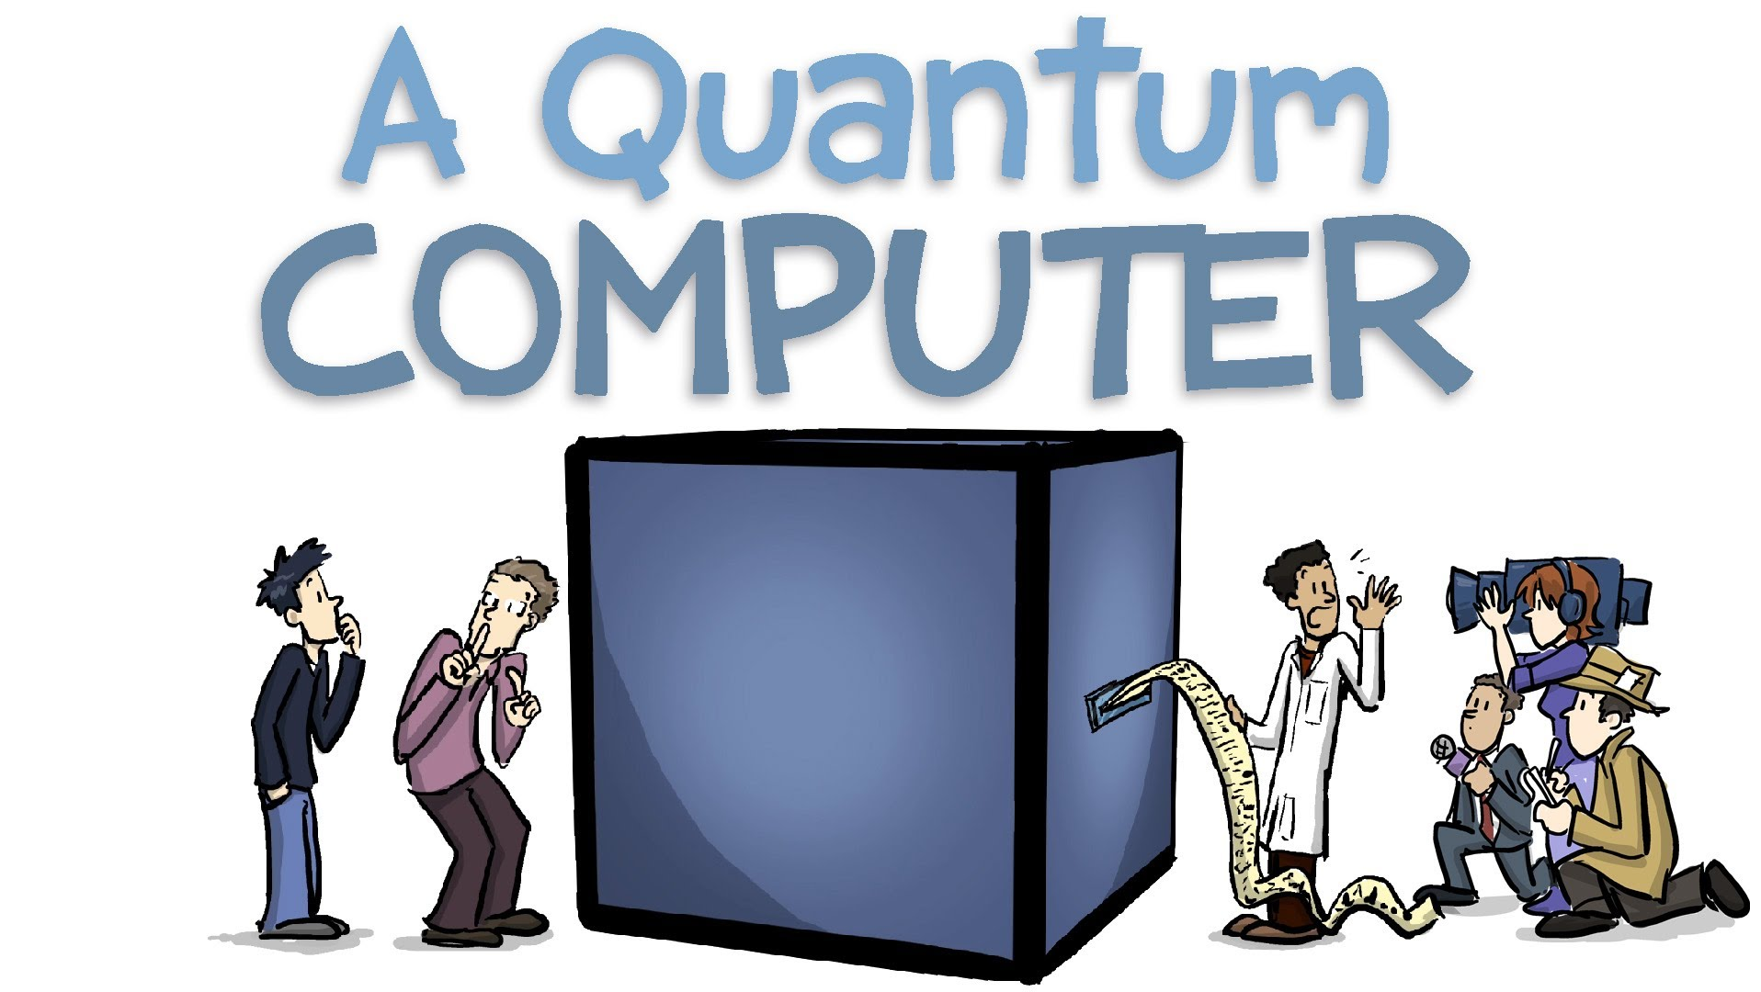

Slide 2
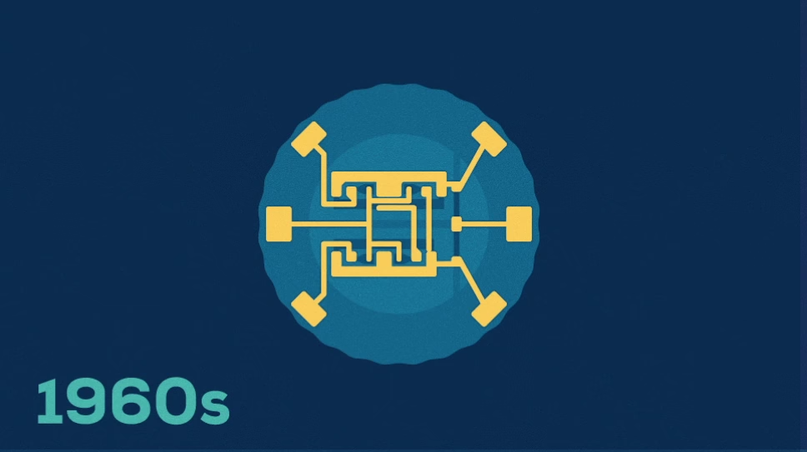

Slide 3
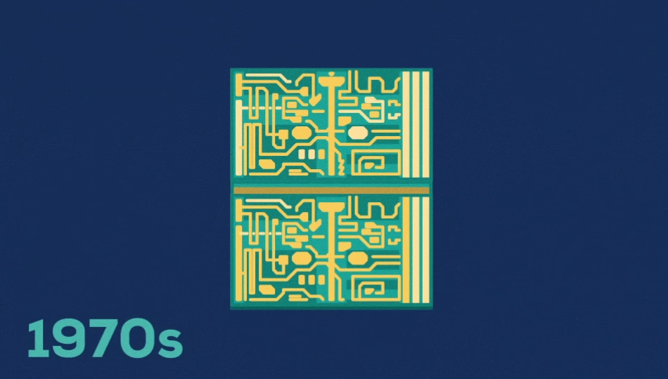

Slide 4
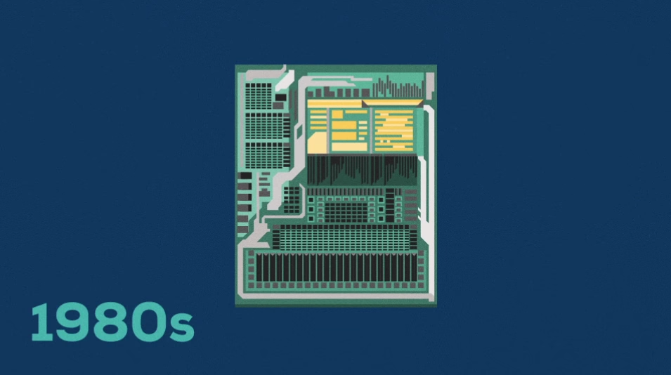

Slide 5


Slide 6
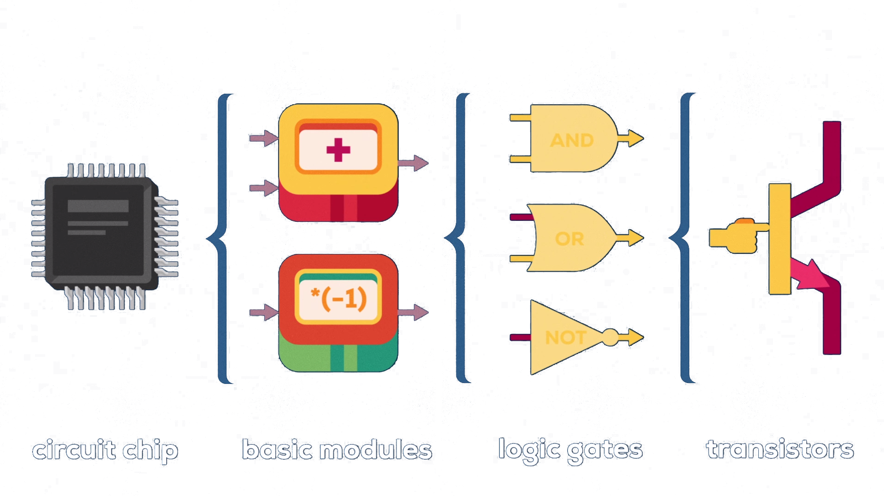

Slide 7


Slide 8


Slide 9


Slide 10
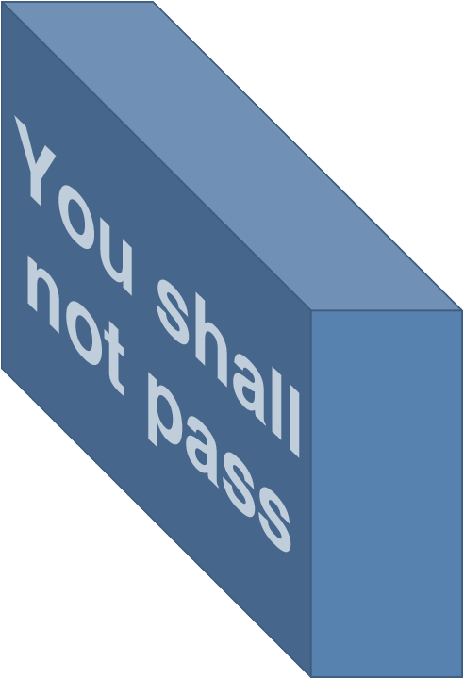

This is a transistor
You have no power here!
Ha-ha!

Slide 11
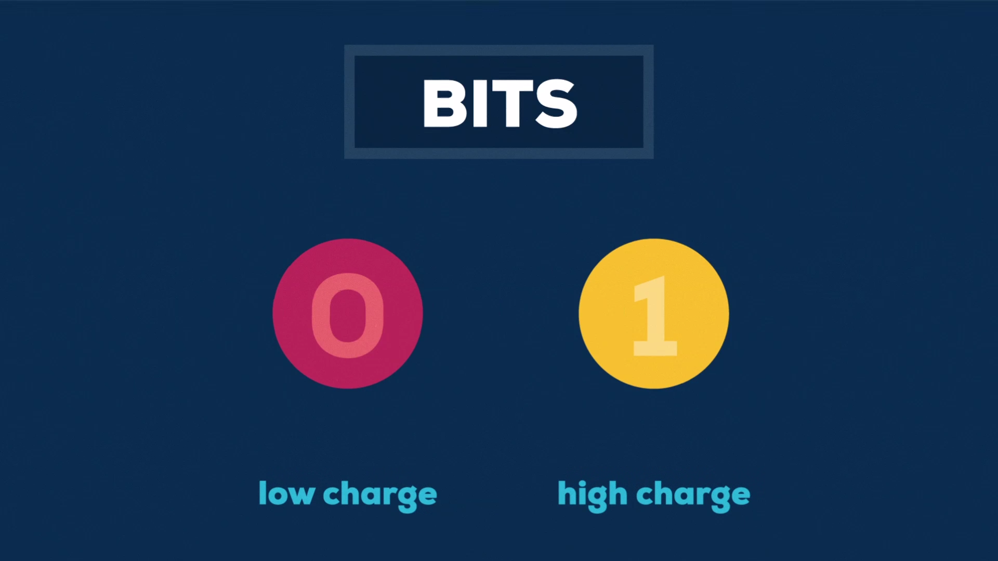

Slide 12


Slide 13





Slide 14
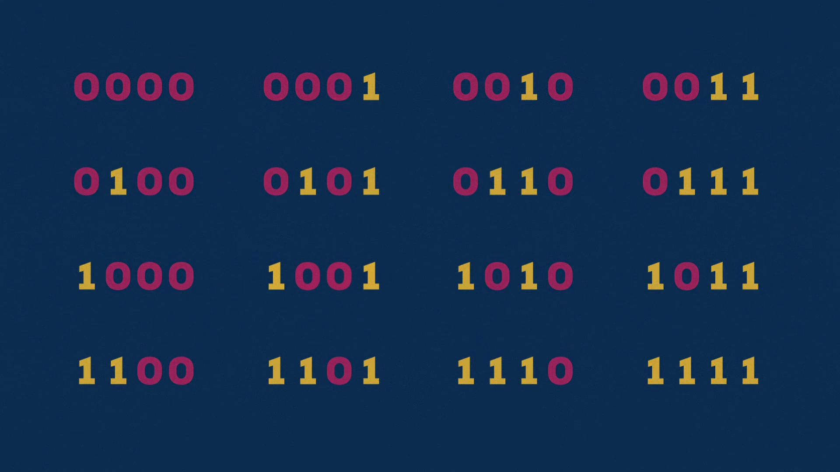
1 of 2⁴

Slide 15
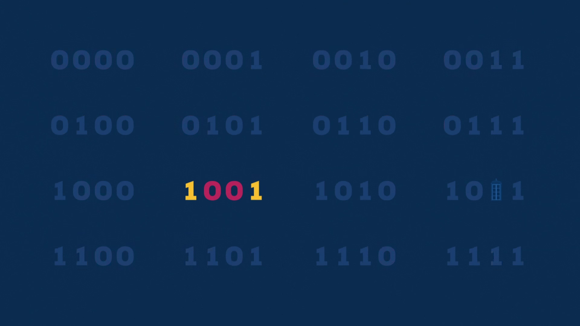
1 of 2⁴

Slide 16
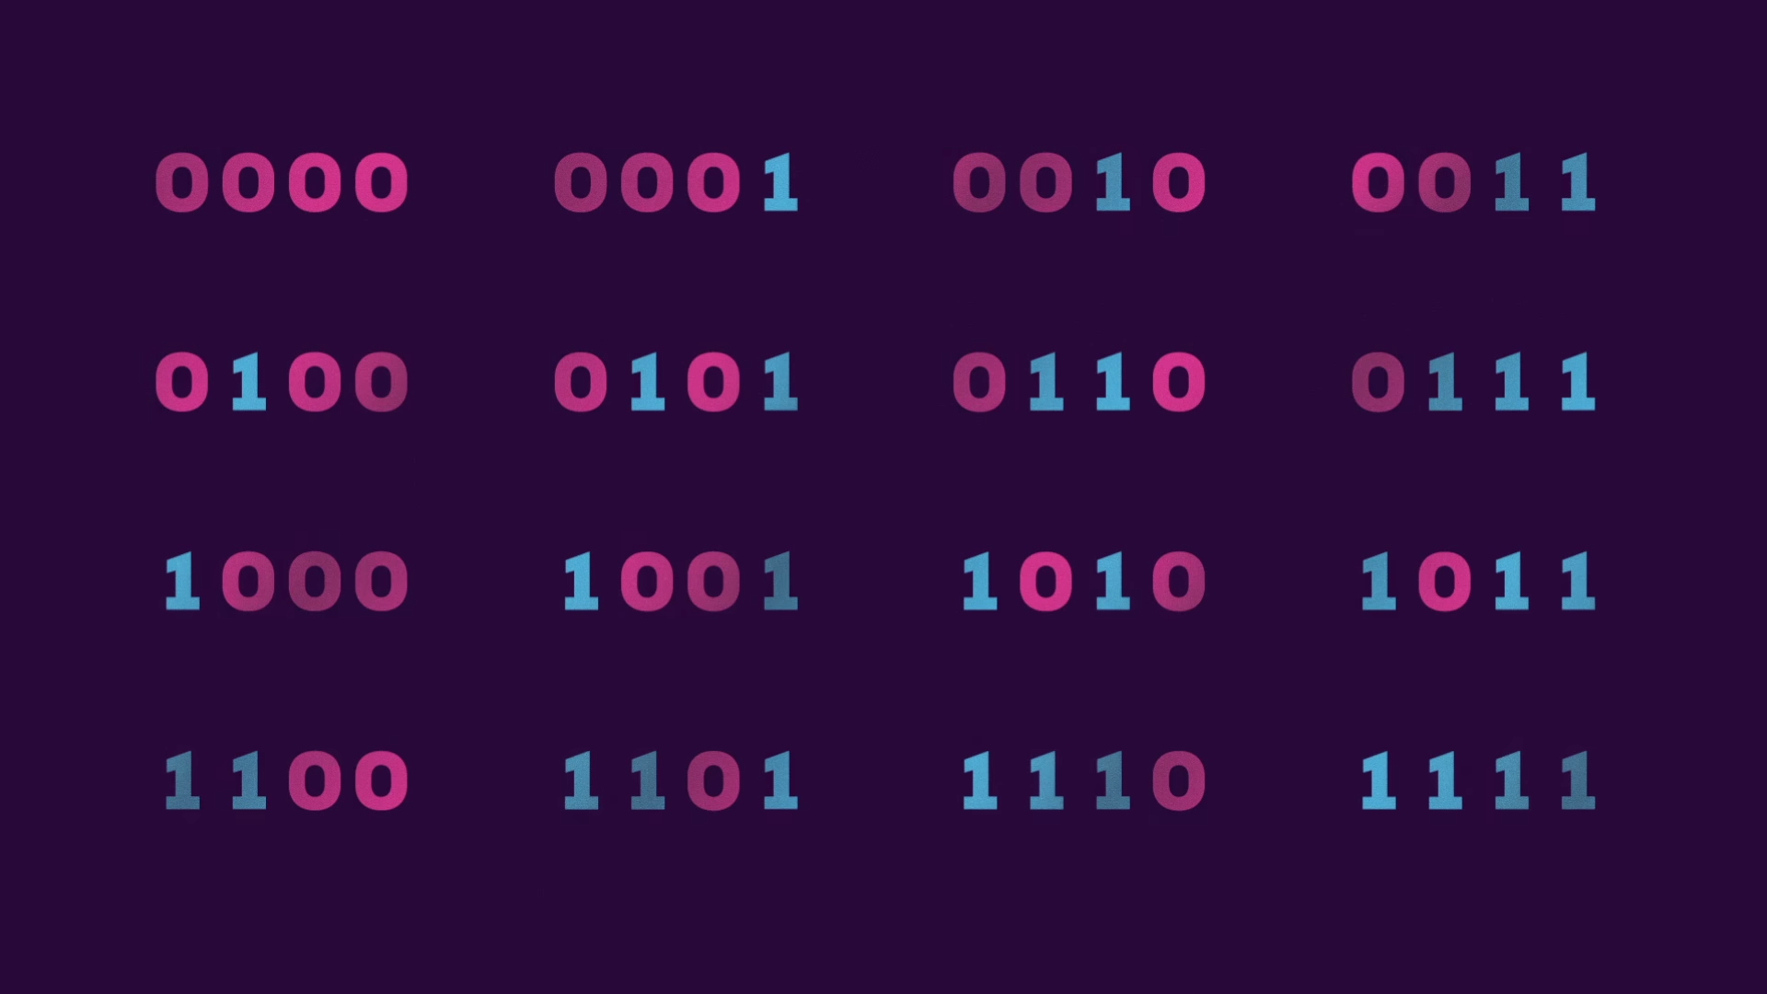
All 2⁴ at once

Slide 17
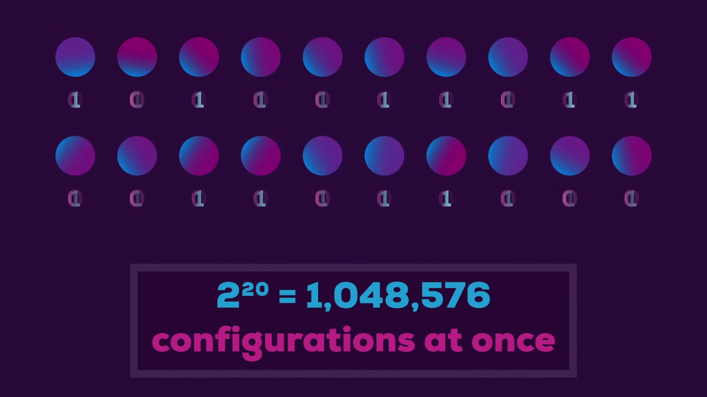

Slide 18
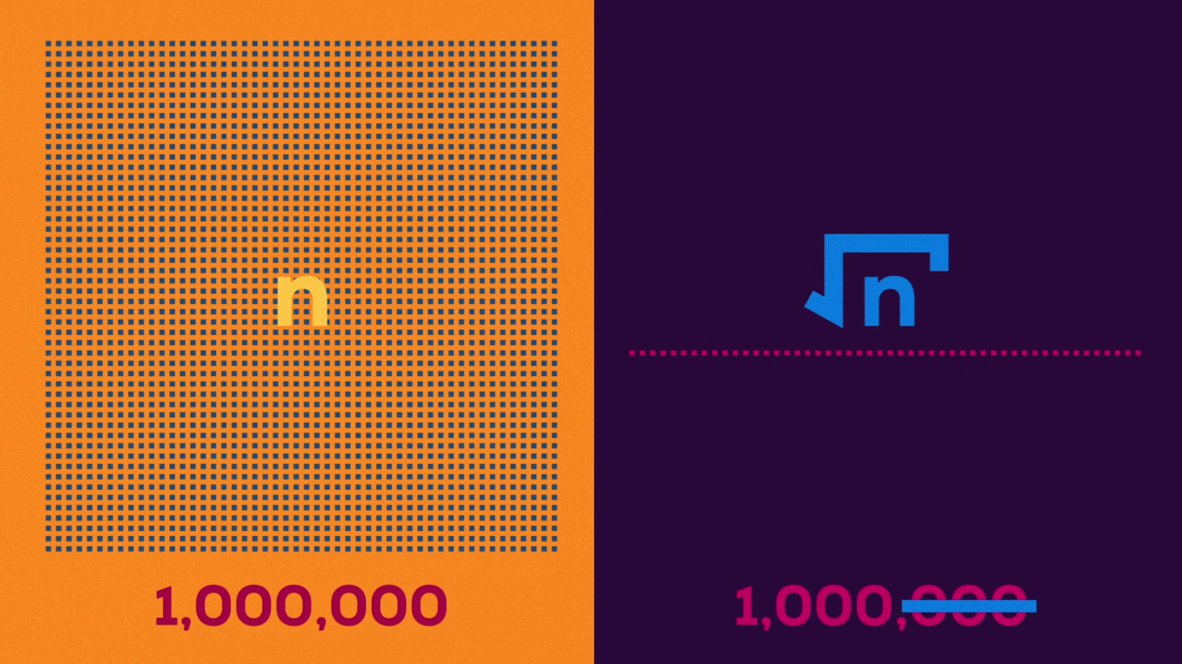

Slide 19
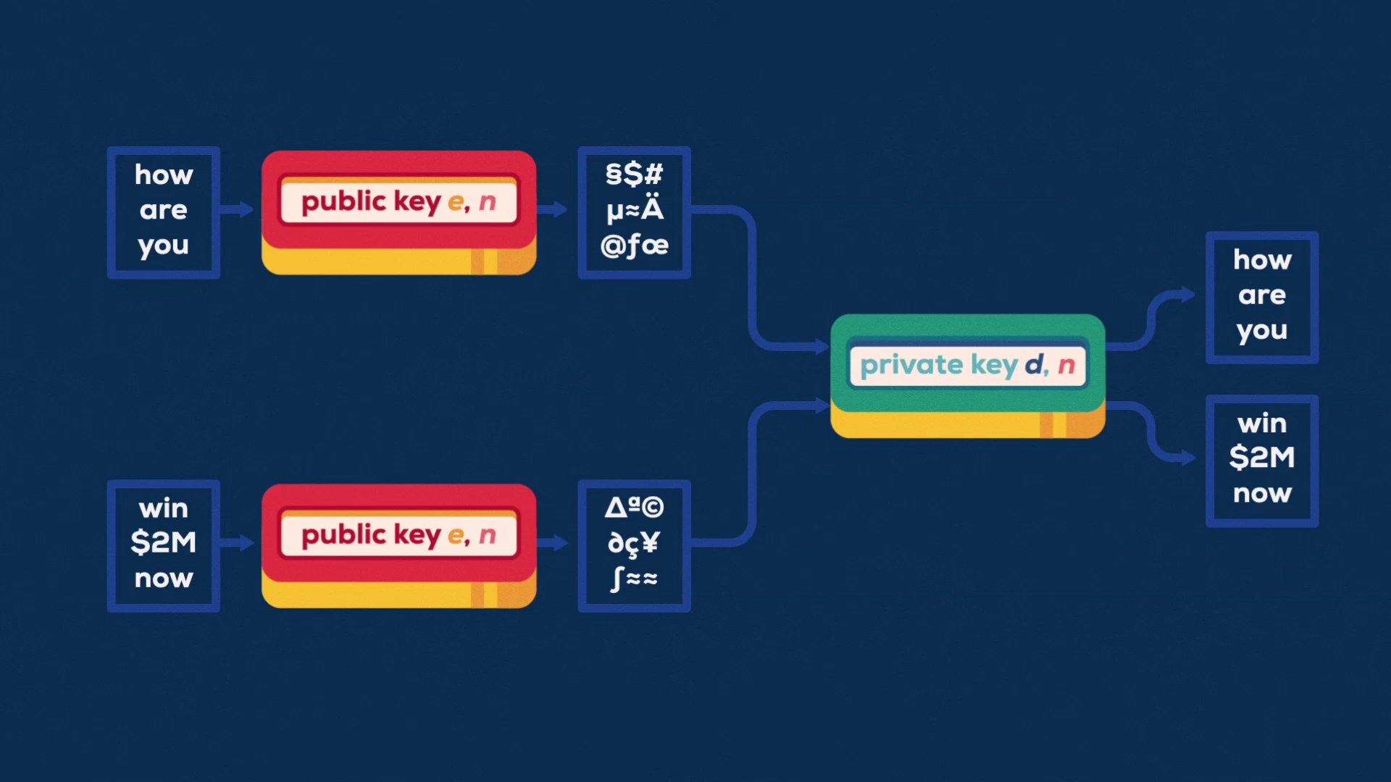

Slide 20


Normal computer

Slide 21
Quantum computer
Done!!

Slide 22


Slide 23

This a quantum computer

Slide 24

Thanks for watching!
Yeah, thank you a lot!

